Slide 1
Solving Chronic Pain with Closed-Loop Neuromodulation
Systems and Controls 2021
Team 6: Emma Whitehead, Yuqi Zhang, Stanley Zhu, Miles Lee, Vivian Li

Slide 2
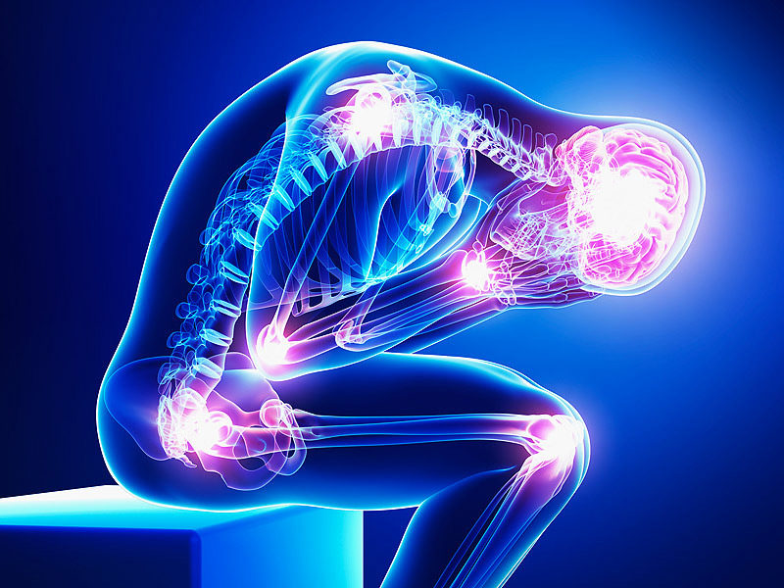
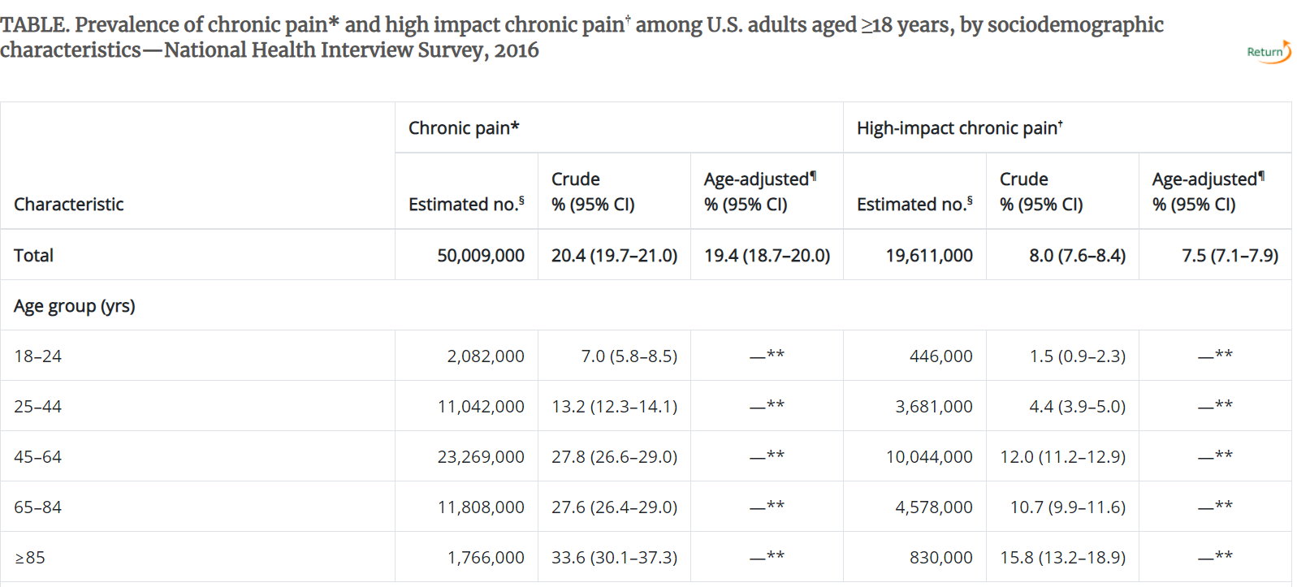
Introduction and Description of data
Problem:
Chronic pain affects an estimated 20.4% of U.S. adults¹
Contributes to high healthcare costs and lost productivity.
Neuromodulation has shown results in reducing side effects.
PNS approaches are
1) open loop
2) lack the ability to suppress pathological pain.
Solution Approach:
Use a close loop
Fitting model using a PID control system.
Notes:
Interagency Pain Research Coordinating Committee. National pain strategy: a comprehensive population health-level strategy for pain. Washington, DC: US Department of Health and Human Services, National Institutes of Health; 2016.

Slide 3
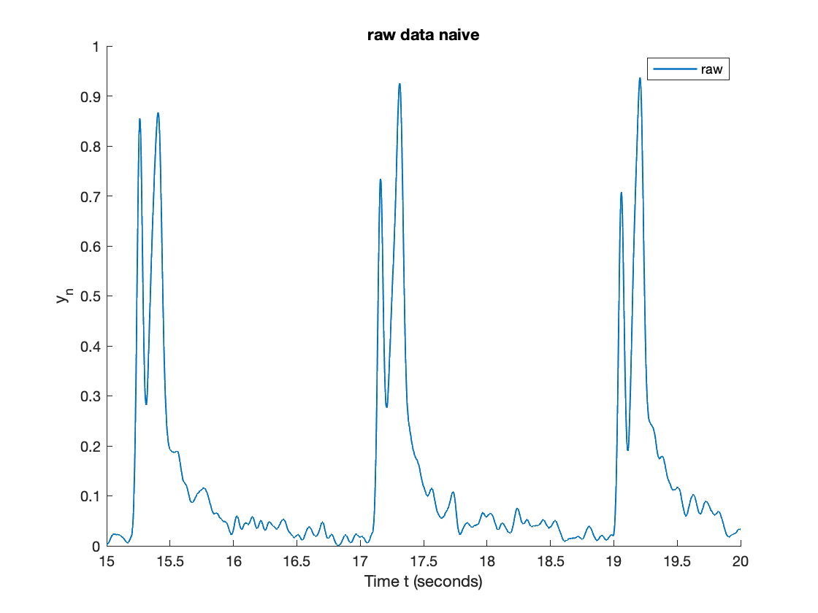
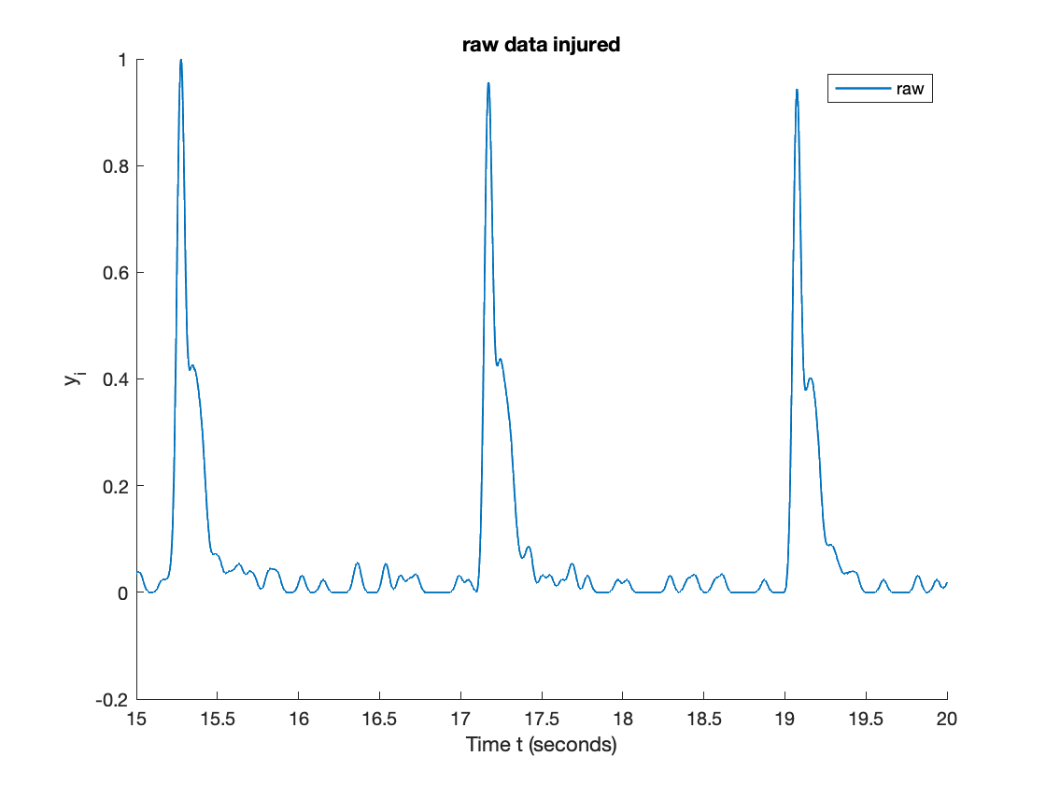
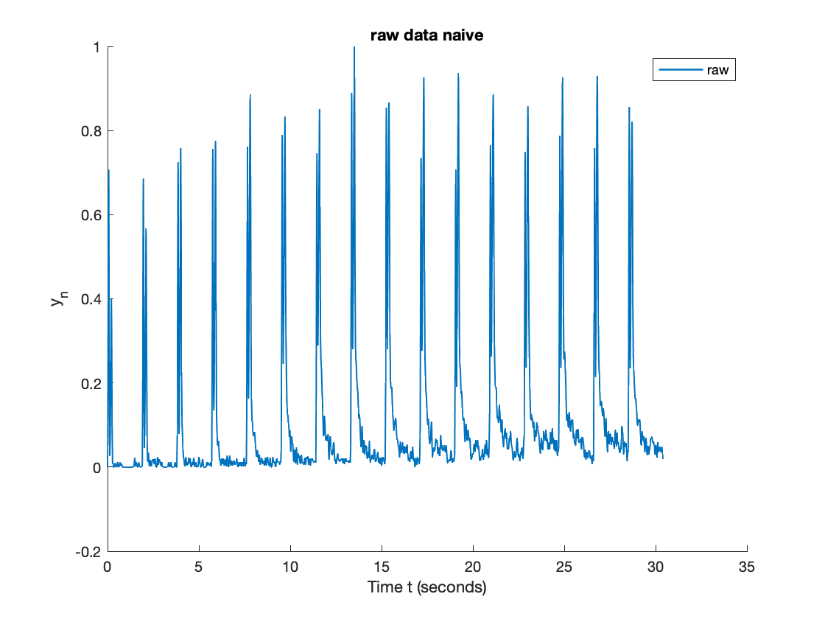
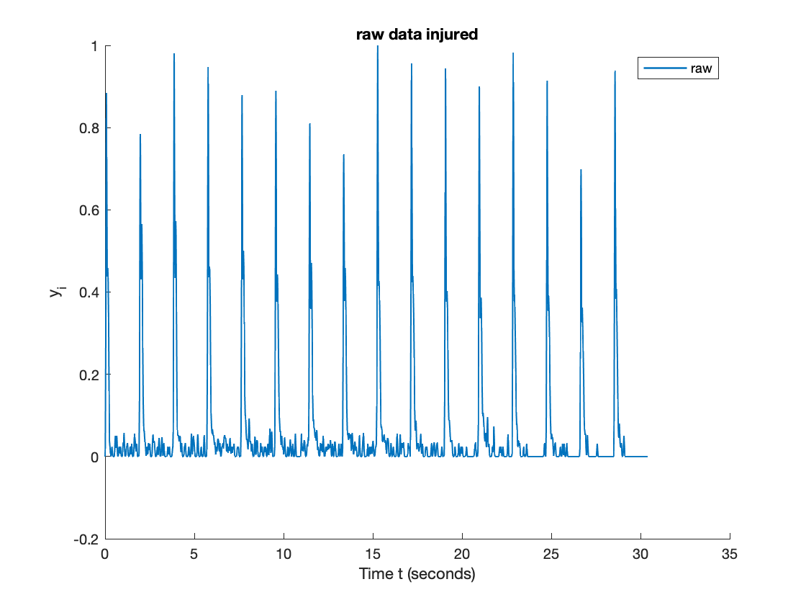

Slide 4
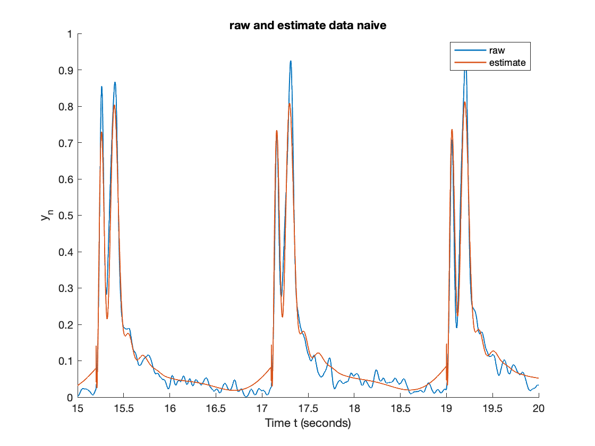
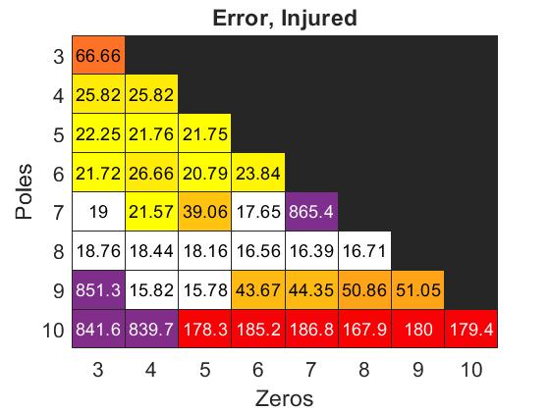
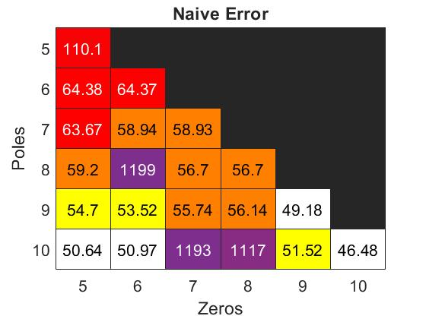
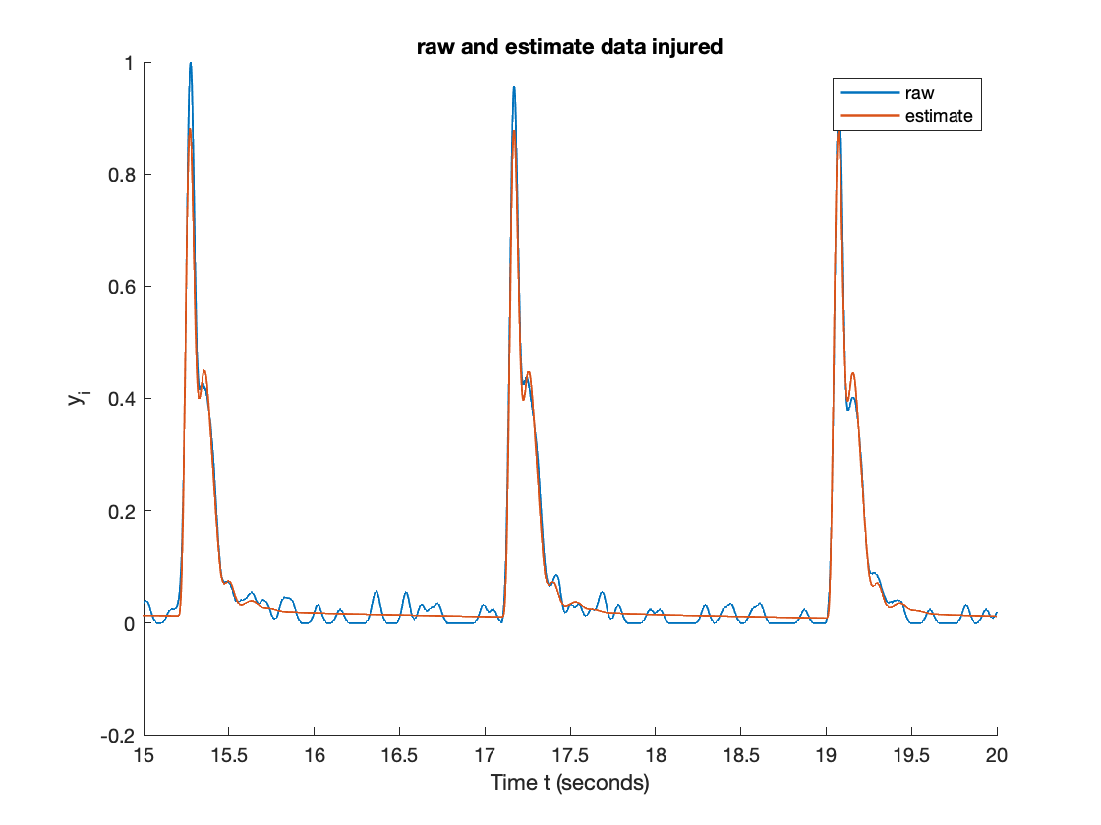
Part 1: Error Calculations and Models Fits
 | naive | injured
zeros | 9 | 5
poles | 9 | 9

Slide 5
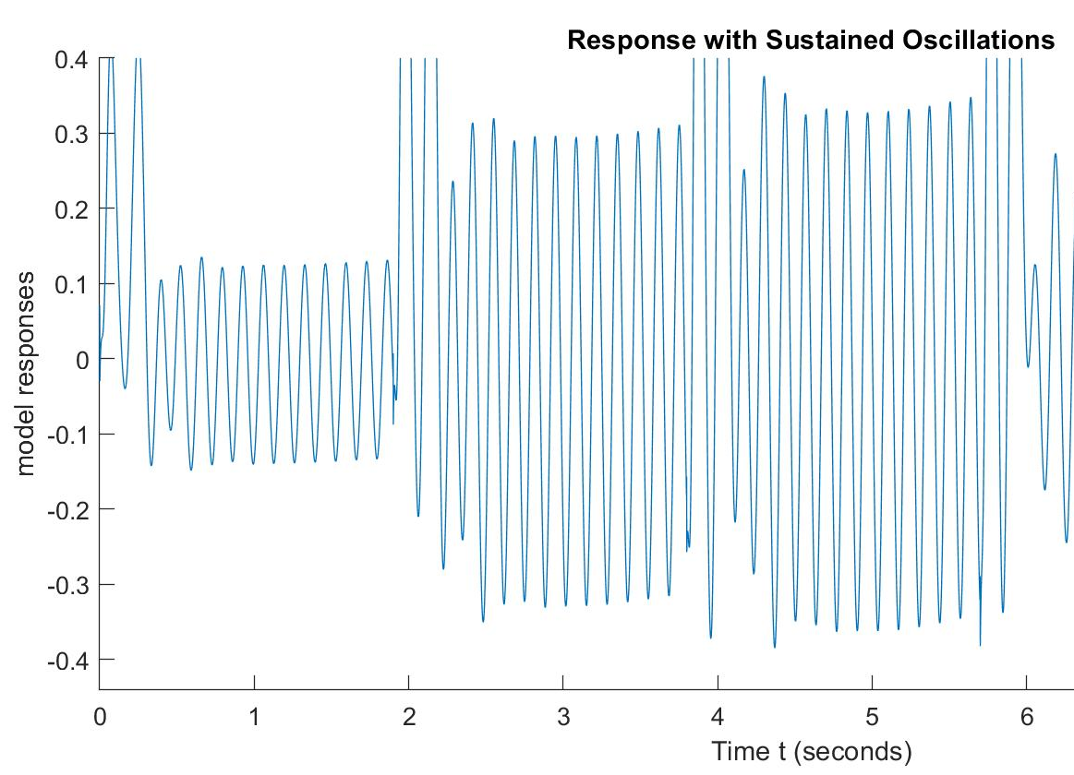
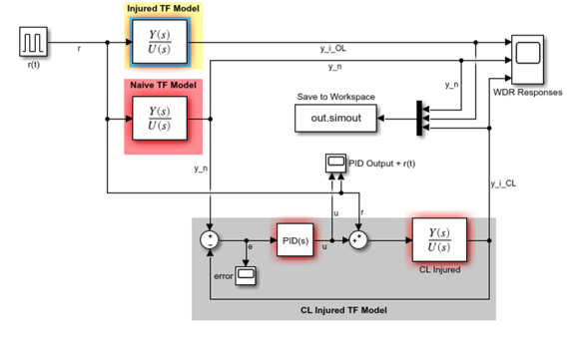

Part 2: Control Design/Architecture and Tuning Method
Control Design
Architecture
PID Controller
Ziegler Nichols Tuning Method
Set Ki Kd to zero, and increase Kp until it reaches a critical gain Kcr
At which the output starts to oscillate constantly
estimates future errors based on the derivative
proportional to the current error
Set the parameters according to the critical gain Kcr and the oscillation period Pcr
integrates the past errors
Notes:
Simulation of Ziegler-Nichols PID Tuning for Position Control of DC Servo Motor
Toe Toe Hlaing
Department of Electrical Systems and Instrumentation, Myanmar Aerospace Engineering University

Slide 6
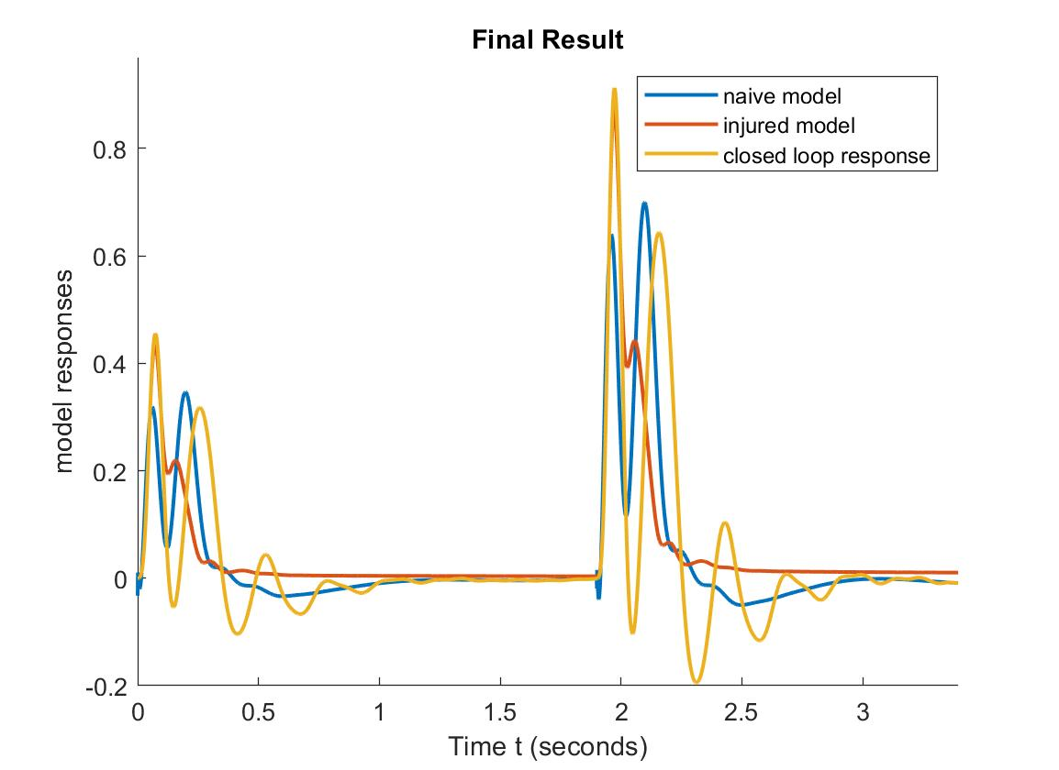
Closed Loop Results
Ziegler Nichols Tuning Method Rules
 | Kp | Ki | Kd
Classic PID | 0.6Kcr | 1.2Kcr/Pcr | 0.075KcrPcr
Pessen Integral Rule | 0.7Kcr | 1.75Kcr/Pcr | 0.105KcrPcr
Some overshoot | 0.33Kcr | 0.66Kcr/Pcr | 0.11KcrPcr
No overshoot | 0.2Kcr | 0.4Kcr/Pcr | 0.066KcrPcr
Kp_final = 0.028875;
Ki_final = 0.543932;
Kd_final = 0.000575;
Notes:
After we get the Critical K and Critical P value, the Zielger Nichols method offer several rules for us to use to obtain the final Kp Ki and Kd value. The third and fourth one don’t work well, and among the first two, we decide to choose the Pessen Integral Rule because we observe that the second peak of the closed loop response catch up with the naive model a lot better. The limitation of this result is that we have an overshoot at the first peak and a right shift in the second peak, but this happen for both set of rules. The Pessen Integral Rule also have a slightly bigger oscillation after the second peak. Overall the PID control and this tuning method creates a response that is closer to the naive model, and we need future research to deal with the limitation of this result.

